Slide 1


Chapter 1: Fundamentals Review
CCNP SWITCH v7.1: Implementing Cisco IP Switched Networks

Slide 2
Chapter Objectives
Hubs and Switches
Switches of today
Broadcast domains
MAC addresses
The basic Ethernet frame format
Basic switching function
VLANs
The Spanning Tree Protocol
Trunking
Port channels

Slide 3
Hubs, transparent bridges, and Switches
Hubs are archaic. They are shared-bandwidth devices
Layer 1 (physical later) device. Passes on a signal to other ports
A switch allows each connected device to have dedicated bandwidth
A basic switch is a Layer 2 device
Transparent bridge usually joined two homogenous or non-homogeneous LAN segments together.
Switches assemble signals into a frame, then by using an algorithm previously used by transparent bridges, determines what to do with a frame.
Once a switch decides where the frame should be sent, passes the frame out the appropriate port(s)

Slide 4
Switches of Today
Most modern switches can actually route traffic.
Switches can prioritize traffic, support no downtime through redundancy, and provide convergence services around IP telephony and wireless networks.
Features of today’s Switches
Application intelligence – recognize applications and prioritize to provide the best user experience
Unified network services – combining the best elements of wireless and wired networking to allow you to consistently connect to any resource or person with any device
Nonstop communications – redundant hardware, nonstop forwarding and stateful switchover (NSF/SS) technology
Integrated security – first line of defense against internal attacks
Operational manageability – IT staff can remotely configure and manage devices from a central location

Slide 5
Broadcast Domains
A broadcast domain is a set of network devices that receive broadcast frames originating from any device within the group.
Generally limited to a specific layer 2 segment that contains a single IP subnet.
A layer 3 device such a router bound broadcast domains. MAC Addresses
Standardized data link layer addresses required for every port or device that connects to a LAN
6 bytes long and controlled by the IEEE

Slide 6
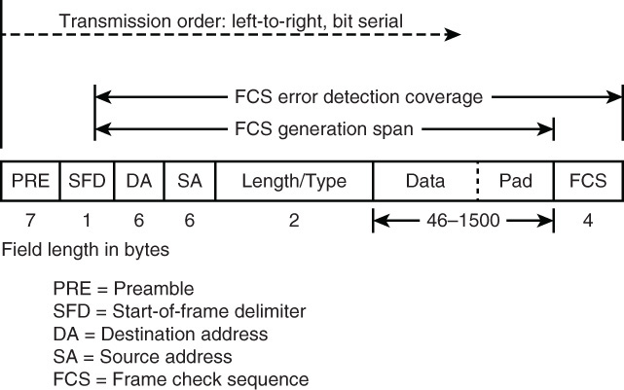
The Basic Ethernet Frame format

Slide 7
Basic Switching Function
A switch must decide what to do with a frame that it receives. It can ignore the frame, pass the frame out of a particular port, or pass the frame out of many ports.
To make this decision, the switch must learn the location of all devices on the segment.
This location is placed in a content addressable memory table (CAM)
The CAM table shows for each device, the MAC address of that device, out of which port the address can be found, and with which VLAN this port is associated.
This CAM information is used to decide how are received frame is handled.
The switch follows some rules for determining forwarding responsibility.
If the destination MAC address is found in the CAM table, the switch sends the frame out of the port associated with that destination MAC address. This process is called forwarding

Slide 8
Basic Switching Function
If the associated port to send the frame out is the same port that the frame came in on, there is no need to send the frame back out that port, and the frame is ignored. This process is called filtering.
If the destination MAC address is not in the CAM table (an unknown unicast) the switch sends the frame out all other ports in the same VLAN as the received frame, except the receiving port. This process is called flooding.
If the destination MAC of the received frame is the broadcast address (FFFF.FFFF.FFFF.FFFF), the frame is sent out of all ports that are in the same VLAN, except the receiving port. This process is also called flooding.

Slide 9
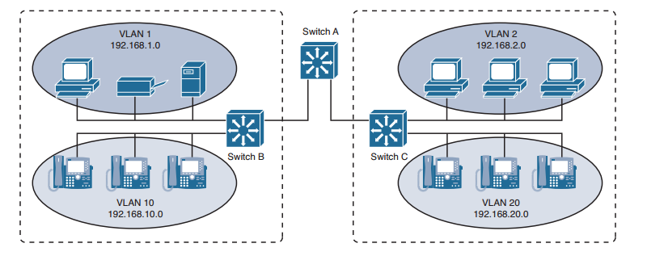
VLANs
Virtual local-area network (VLAN) is logic inside a switch allowing it to choose ports for special groupings.
The switch ensures that traffic from one group of ports never get sent to other groups of ports (which would be routing)
VLANs are broadcast domains. All ports that are in the same VLAN are in the same broadcast domain.

Slide 10
The Spanning Tree Protocol
As the switch forwarding algorithm floods unknown and broadcast frames out of all ports that are in the same VLAN as the received frame, this could cause flooded frames that are connected in a physical loop, to pass the frames around the loop forever.
To allow for the benefit of redundancy, without breaking the network because of flooding, a protocol called the Spanning Tree Protocol (STP) was created, that later became standardized as IEEE 802.1D specification.
The purpose of STP is to identify and temporarily block loops in a network segment or VLAN.
SPT involves electing a root bridge or switch, with other switches measuring their distance from the root switch.
SPT is dynamic: if a link in the segment fails, ports that were originally blocked can be changed to the forwarding mode.

Slide 11
Trunking
Trunking is a mechanism that is most often used to allow multiple VLANs to function independently across multiple switches
A port usually belongs to a single VLAN.
A trunk port is a port that can be configured to send and receive traffic for many VLANs
This is accomplished by attaching VLAN information to each frame via a process called tagging the frame.
Port Channels
Group together ports to work as one unit.
Distribute traffic across all the links and provide redundancy if one or more links fail.
Settings must be the same on both sides of the links involved in the channel

Slide 12


